Slide 1


Deep Learning Project
Facial Emotion Recognition in Job interviews
Ruqaiah Abdullah
Alanoud Alzhrani
Annal Albeeshi

Slide 2


Slide 3
Table of Contents
Introduction
Dataset & EDA
Methodology
Results
Future Works
Conclusion

Slide 4

Introduction

Slide 5

Ministry of Human Resources and Social Development

Slide 6
Using facial emotion recognition to prospective candidates based on some factors
Finding the person whose personality and characteristics are best suited to the job
Building a Convolutional Neural Network model that uses the dataset images to determine the correct emotion type of a person face

Slide 7
Dataset
Kaggle.com
32,298 of gray scale images
divided into train and test dataset
28,709 images of train set
3,589 images of test set

Slide 8
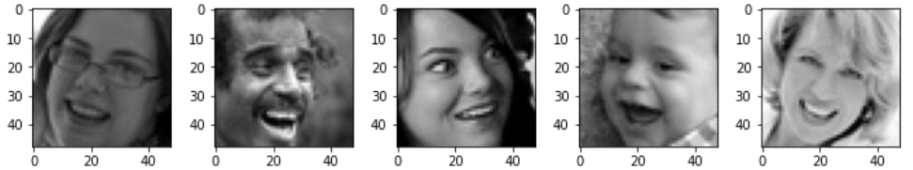
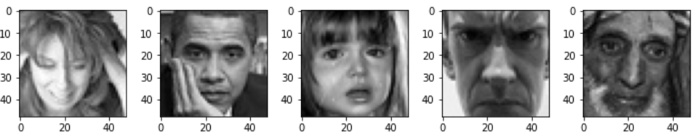
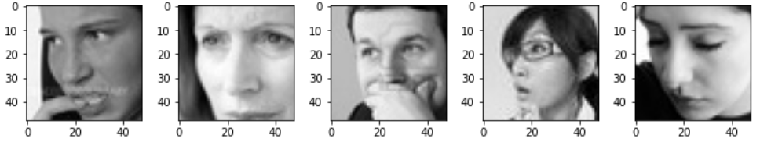
Images are categorized based on the emotion
shown in the facial expressions
(happiness, neutral, sadness, anger, surprise, disgust, fear)

Slide 9
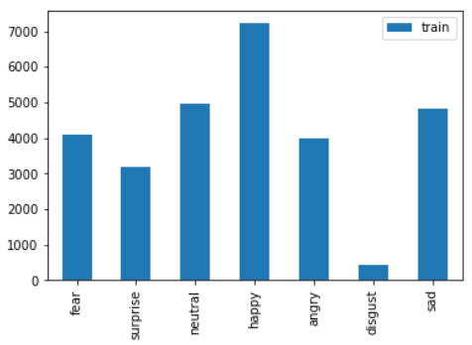
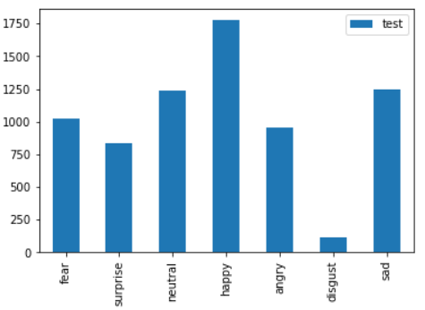
Exploratory Data Analysis
Fig 1: EDA for training set
Fig 2: EDA for testing set

Slide 10
Models
Convolutional Neural Networks (CNN)

Slide 11
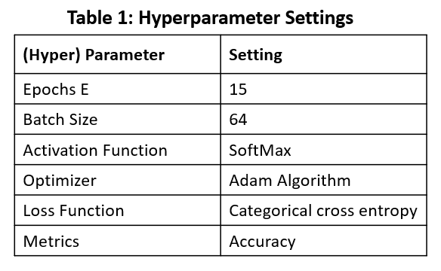
Model build settings:
Callbacks Function:
1.Model Check point.
2.Early Stopping.
Hyperparameter Settings:
As shown in Table 1

Slide 12
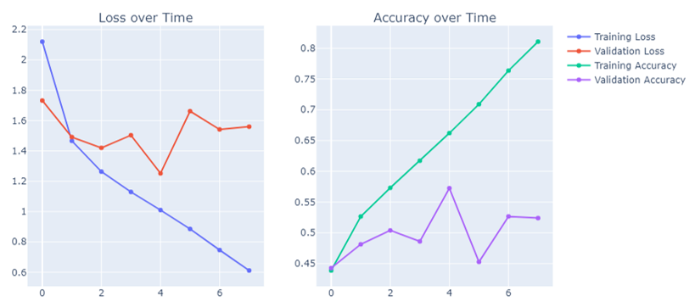
First Model Results:
By training the CNN model using 15 epochs, the accuracy results are constantly improving from 39 to 87
Fig 3: the results for the first model

Slide 13
Experiments

Slide 14
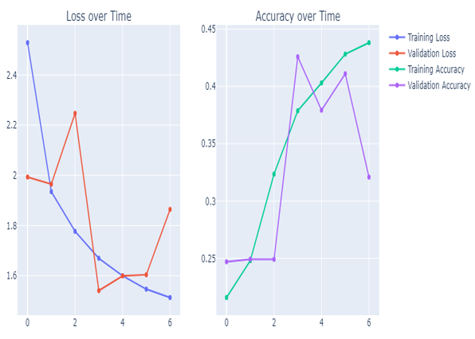
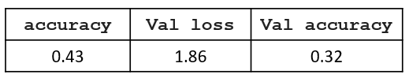
Experiment #1
Fig 4: the results for Experiment 1

Slide 15
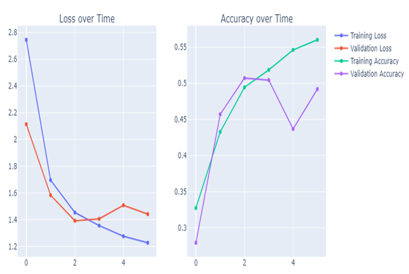
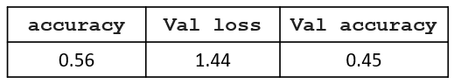
Experiment #2
Fig 5: the results for Experiment 2

Slide 16
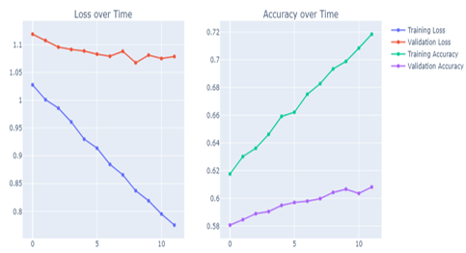
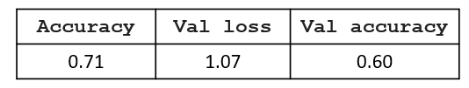
Experiment #3
Fig 6: the results for Experiment 3

Slide 17
Final Model & Best Result

Slide 18
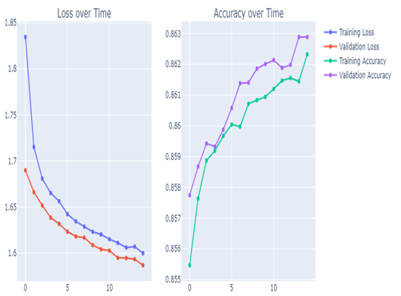
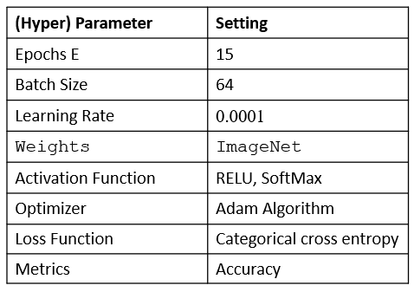
VGG16 with Transfer Learning
Fig 7: the results for VGG16 Model
Best Results
Test Accuracy: 0.86

Slide 19


Slide 20




Future Work
Crime Investigation
Airports Inspection
Customer satisfaction
Digital Advertising

Slide 21

Conclusion
Build a Convolutional Neural Network (CNN) and VGG16 by Transfer Learning models to get the best result to apply on facial emotion recognition.
Facial emotion recognition can be used on jobs interviews field
by Human Resources and Social Development.
Easier to find the person whose personality and characteristics
are best suited to the job.

Slide 22
THANKS!
Do you have any question?

